Slide 1









My Number Interactive Notebook
$$×$$
$$\frac{1}{2}$$
$$÷$$
$$+$$
$$−$$
$$\frac{3}{5}$$
$$7$$
Name
Class
Teacher
Term 1 Semester 1
$$5^{2}$$
$$\sqrt{9}$$
1

Slide 2
Contents
Glossary or Formula Page
Page
Date
Description
2
3

Slide 3
Tasks
24
7
30
Essential Question
Questions
Notes
Summary

Slide 4
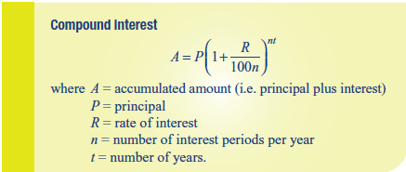
24
7
30
Date
Compound Interest
EQ – How is Compound Interest different from Simple Interest?
What is the formula used to calculate Compound Interest?

Slide 5

24
7
30
Date
Compound Interest
EQ – How is Compound Interest different from Simple Interest?
What is the formula used to calculate Compound Interest?
Example

Slide 6
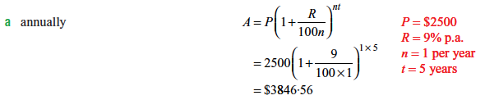
24
7
30
Date
Compound Interest
EQ – How is Compound Interest different from Simple Interest?
What is the formula used to calculate Compound Interest?

Slide 7
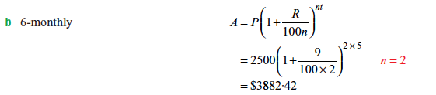
24
7
30
Date
Compound Interest
EQ – How is Compound Interest different from Simple Interest?
What is the formula used to calculate Compound Interest?

Slide 8
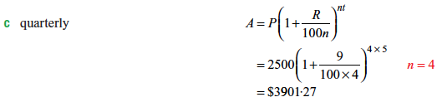
24
7
30
Date
Compound Interest
EQ – How is Compound Interest different from Simple Interest?
What is the formula used to calculate Compound Interest?

Slide 9
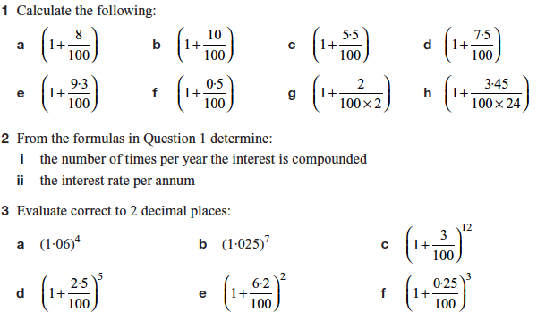
Task

Slide 10
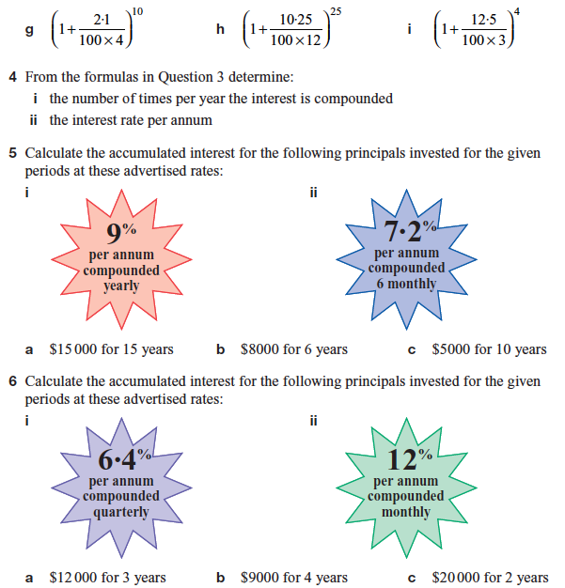
Task

Slide 11
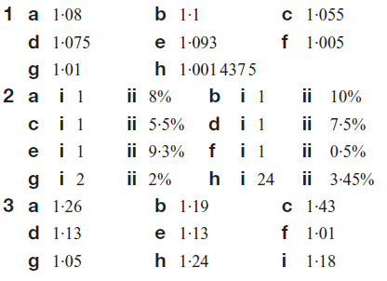
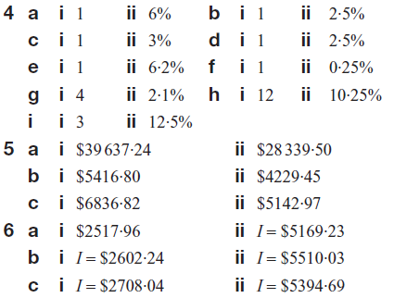
Answers

Slide 12
Notes Review
24, 7 ,30
Date
Title
Essential question
Notes complete
Notes complete with colour and diagrams
Questions completed
Contents page filed in
Formula page filled in

Slide 13
Homework
Review your notes and write a summary answering the essential question.

